Slide 1
HTML & CSS
Binary Studio Academy

Slide 2
HTML

Slide 3
What is HTML?
HTML (HyperText Markup Language) - it is a markup language used to tell your browser how to structure the web pages you visit.
An element is a part of a webpage. In HTML an element may contain a data item or a chunk of text or an image, or perhaps nothing.
<h1 class="custom-title">Binary Studio Academy</h1>
<img src="./logo.svg" alt="Logo">

Slide 4
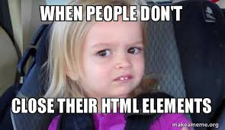
Nesting elements
<div>Our cat’s name is <strong>Bulka</div></strong> <!-- Error -->
<div>Our cat’s name is <strong>Bulka</strong></div> <!-- Correct -->

Slide 5
Block versus inline elements
Block elements:
<div>
<ul>
<table>
<p>
<form>
...
Inline elements:
<span>
<img>
<input>
<label>
<strong>
...
Formatting: by default, block-level elements begin on new lines, but inline elements can start anywhere in a line.
Content model: generally, block-level elements may contain inline elements and other block-level elements. Inherent in this structural distinction is the idea that block elements create "larger" structures than inline elements.

Slide 6
HTML structure
<!-- <!DOCTYPE html PUBLIC "-//W3C//DTD XHTML 1.0 Transitional//EN"
"http://www.w3.org/TR/xhtml1/DTD/xhtml1-transitional.dtd"> -->
<!DOCTYPE html>
<html lang="en">
<head>
<meta charset="UTF-8">
<title>Document</title>
<link rel="stylesheet" href="style.css">
<script src="app.js"></script>
</head>
<body>
<p>Hello World!</p>
<script src="libs.js"></script>
</body>
</html>

Slide 7


Slide 8
CSS

Slide 9
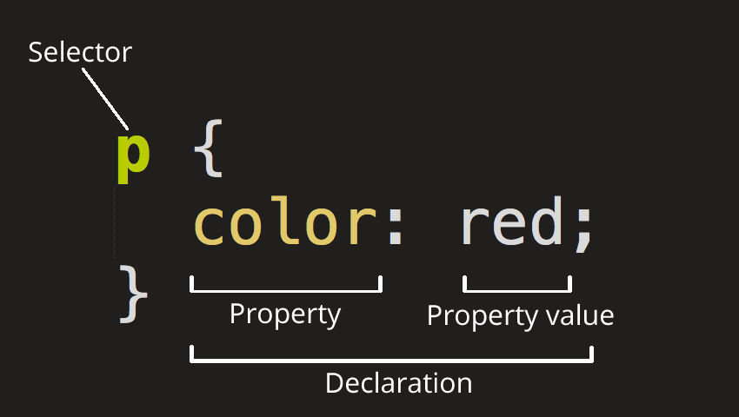
What is CSS?
CSS (Cascading Style Sheets) - it is a style sheet language used for describing the presentation of a document written in a markup language like HTML. CSS is a cornerstone technology of the World Wide Web, alongside HTML and JavaScript.

Slide 10
Selectors
Simple selectors
h1 { /*...*/ }
#module { /*...*/ }
.item-list { /*...*/ }
Attribute selectors
input[type="checkbox"] { /*...*/ }
Pseudo-classes
.link:hover { /*...*/ }
Pseudo-elements
.comment::before { /*...*/ }
Combinators
.menu-wrapper > .menu-item.active { /*...*/ }
Multiple selectors
h1, h2, h3, h4, h5, h6 { /*...*/ }

Slide 11
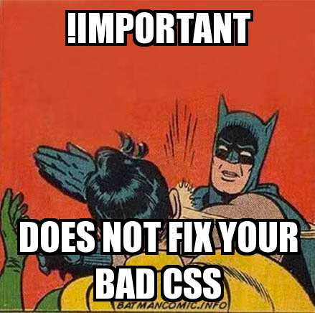
Cascade & inheritance

Slide 12
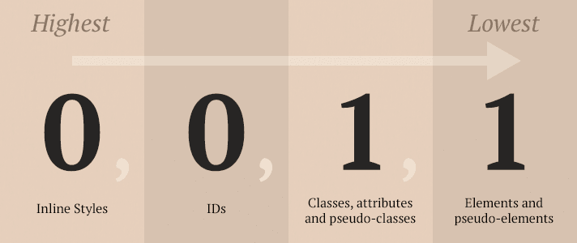
Cascade. Specificity
ul class="list">
<li id="mainItem" class="list-item"></li>
<li class="list-item" style="color: red;"></li> <!-- style: specificity = 1000 -->
<li class="list-item"></li>
</ul>
* { color: black; } /* specificity = 0 */
#menu { color: green; } /* specificity = 100 */
.list > .list-item { color: white; } /* specificity = 20 */
li.list-item { color: black; } /* specificity = 11 */
#menu.list > .list-item { color: blue; } /* specificity = 110 */
.list li.list-item:first-child { color: orange; } /* specificity = 31 */

Slide 13
Values and units
Absolute units (px, mm, sm, in, pt, pc );
Relative units (%, em, rem, vh, vw, cx, ch);
Unitless values;
Colors (key words, hex, rgb(), rgba(), hsl(), hsla());
Functions.
REM vs EM – The Great Debate: https://zellwk.com/blog/rem-vs-em/

Slide 14
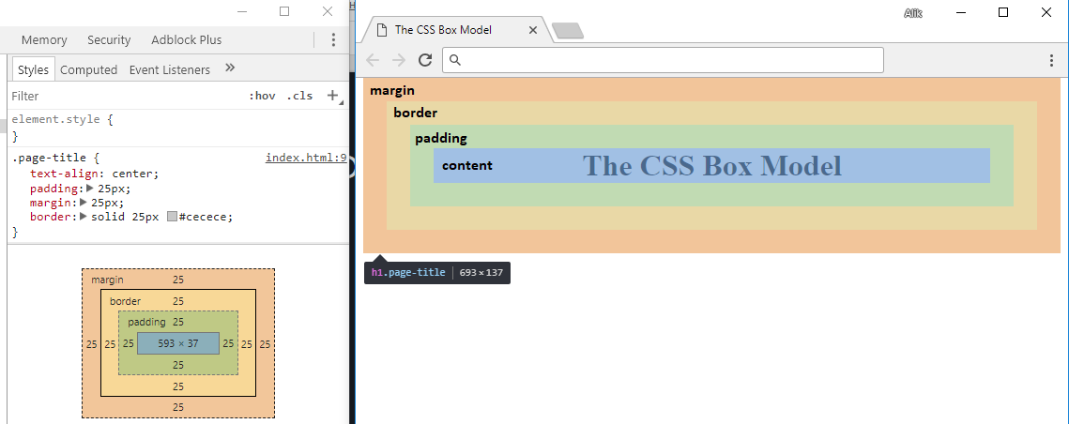
The CSS Box Model
.page-title {
text-align: center;
padding: 25px;
margin: 25px;
border: solid 25px #cecece;
}
<h1 class="page-title">The CSS Box Model</h1>

Slide 15
Types of CSS boxes
display: block; /* by default for block elements (div, ul, form, etc.) */
display: inline; /* by default for inline elements (span, input, strong, etc.) */
display: inline-block;
...

Slide 16
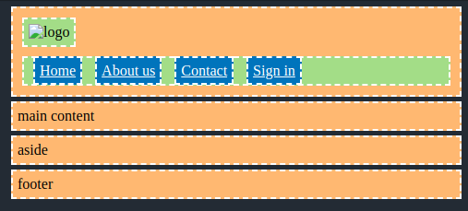
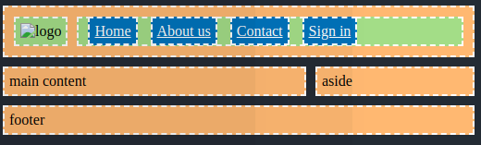
CSS layouts
Normal flow
<header>
<img src="" alt="logo">
<nav>
<a href="">Home</a>
<a href="">About us</a>
<a href="">Contact</a>
<a href="">Sign in</a>
</nav>
</header>
<main>main content</main>
<aside>aside</aside>
<footer>footer</footer>
Changed

Slide 17
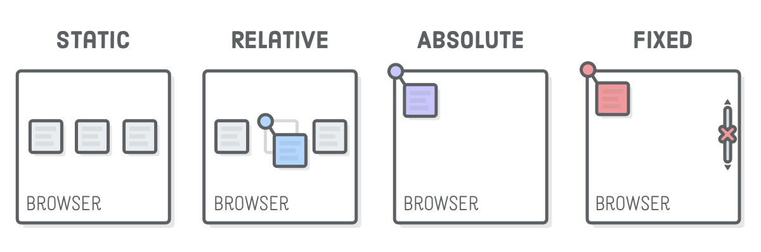
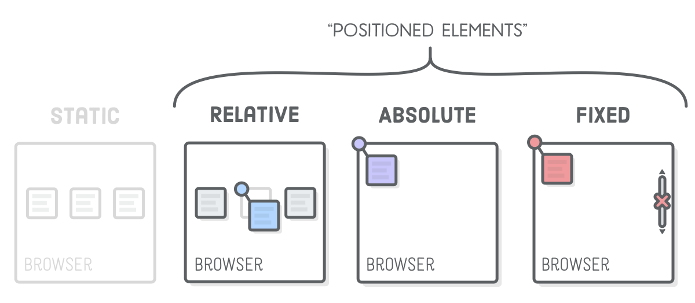
Positioning
Advanced Positioning - https://internetingishard.com/html-and-css/advanced-positioning/

Slide 18
Float? Flexbox? Grid?
All About Floats - https://css-tricks.com/almanac/properties/f/float/
A Complete Guide to Flexbox - https://css-tricks.com/snippets/css/a-guide-to-flexbox/
A Complete Guide to Grid - https://css-tricks.com/snippets/css/complete-guide-grid/

Slide 19
@media
.container{
width: 100%;
}
@media screen {
.container {
width: 100%;
padding: 30px;
}
}
@media all and (min-width: 480px) {
.container {
padding: 5px;
}
}
@media all and (min-width: 768px) and (max-width: 1280px) {
.container {
padding: 20px;
}
}

Slide 20
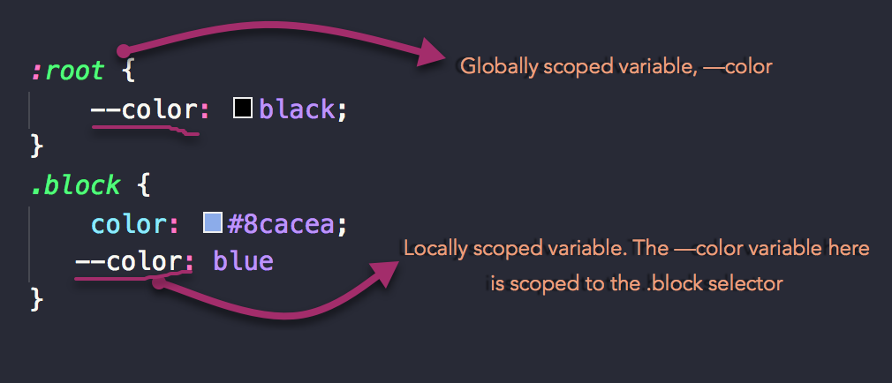
CSS Variables

Slide 21
Best Practice

Slide 22
Done!
Thanks!

